Slide 1


EDUCATION REPORT
WRITING
How and why

Slide 2

WHY WRITE A REPORT
Reports are the easiest way to maintain control over not only what information you provide, but also evidence that you have done so

Slide 3


STRUCTURED AND CHILD LED REPORT DIFFERENCES
In practice, the content of a report should not differ greatly.
The presentation of the content is all that differs

Slide 4
ABOUT THE CHILD
The child is central to the report and should be the subject
The report is not about the parent
The report should not contain information about financial matters
or medical matters not relevant to learning

Slide 5


SPELLING, PUNCTUATION AND GRAMMAR
Others will judge you by how you write, before they consider what you have written
This is a formal document and as such, should be written in formal language

Slide 6
AVOID INCLUDE
Contractions
Text speak
Reference to dangerous actions
Reference to socially unacceptable views
Dogmatic or impolite comment
Bullet point Lists
Excessive reference to school
Prepositions
Determiners
Capital letters for proper nouns
Proper noun in each paragraph
Detail about the provision
Resources list
Social opportunity

Slide 7

SUBJECTS MATTER
Literacy
Numeracy
‘We regard the fundamental academic skills of writing, reading, and arithmetic as fundamental to any education for life in the modern world’. Harrison and Harrison Stevenson 1981

Slide 8
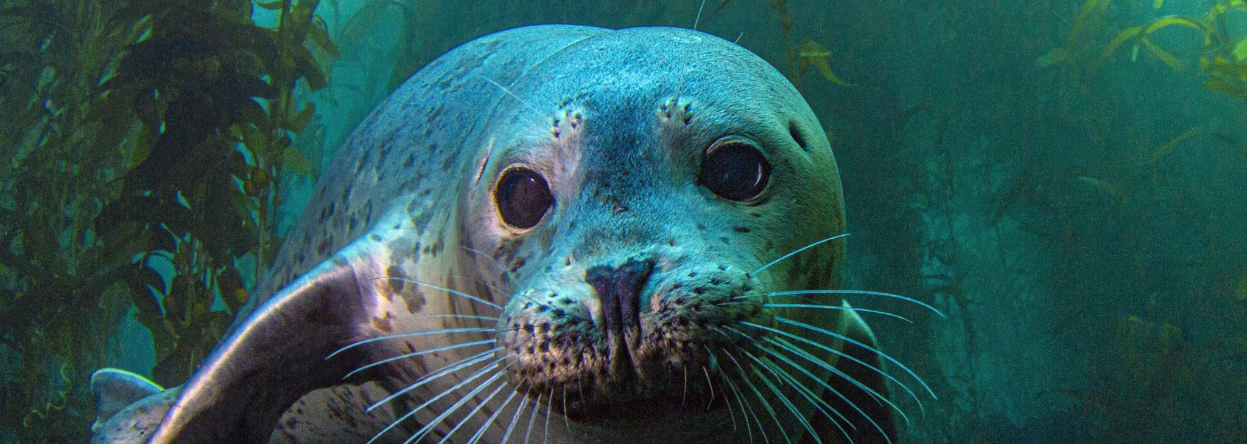
HOW MUCH DETAIL
‘Fred went to the beach’ says nothing about the education.
However, ‘Fred went to the beach to go out in a boat. He saw a seal and asked… discussed cloud formations…studied stratification in the cliffs… studied the tidal patterns…identified seabirds….when we got home Fred researched seal populations by…..he discovered how much they weigh and found that a male seal weighs one granddad, one Fred, two bananas and a…Fred then wrote…..’ demonstrates a suitable education.

Slide 9
LITERACY DETAIL
Spelling
Reading
Writing
Punctuation
Drama
Discussion
Typing
Poetry
Comprehension

Slide 10








NUMERACY
Mental arithmetic
Bank accounts
Shopping
Weighing
Sharing
Scaling
Calculating
Applying

Slide 11

SAMPLES OF WORK
Do not get caught up in discussions of samples or examples
An example of a sample of work:
Fred can now competently add larger numbers and recently
felt very proud of adding
4197 + 1763 = 5960
. Another example of a sample of work:
Fred uses excellent characterisation and recently wrote: ‘He
was disgusted by the weird, little, knobbly knee sporting
creature’.

Slide 12
DETAIL IS CRUCIAL.
DfE guidance LAs to seek ‘detailed information’
How does the child learn
What resources does the child use
How does the child engage with the resources
What is the product of the engagement
What progress has the child made

Slide 13

BEGINNINGS AND ENDINGS
An education report is not a letter and should not be formatted as a letter.
Ending by asking the La to tell you what more it wants, invites extra enquiry which may not be necessary.

Slide 14

SOCIALISATION
Where (HE group, swimming classes…..)
With whom (Friends from…., not named individuals)
How often
Benefit (Describe shared events and learning)

Slide 15
RESOURCE LIST
Give enough detail to clarify the educational value of resources
Do not give too much detail as detail goes in the body of the report

Slide 16

LACK OF DETAIL
‘Fred is fourteen and has lots of interests’ parents should tell the reader about Fred as an individual and his interests, not just that he has interests.
We hope to go to piano class at some point’ is aspirational, general and not about Fred. Parents need to detail Fred’s education.
‘Fred uses Greatstuff for his three core subjects. His average weekly scores are maths 60%, English 56% and science 68%’ tells the reader nothing. Parents should detail what topic Fred is studying, what the scores are for, what level the tests are at or any substantive detail.
‘We learnt about bananas, I bought bananas and we cut them up’ is parent centred, not about Fred. Parents should explain what Fred did, saw, said, experienced and learnt. How has Fred progressed.

Slide 17
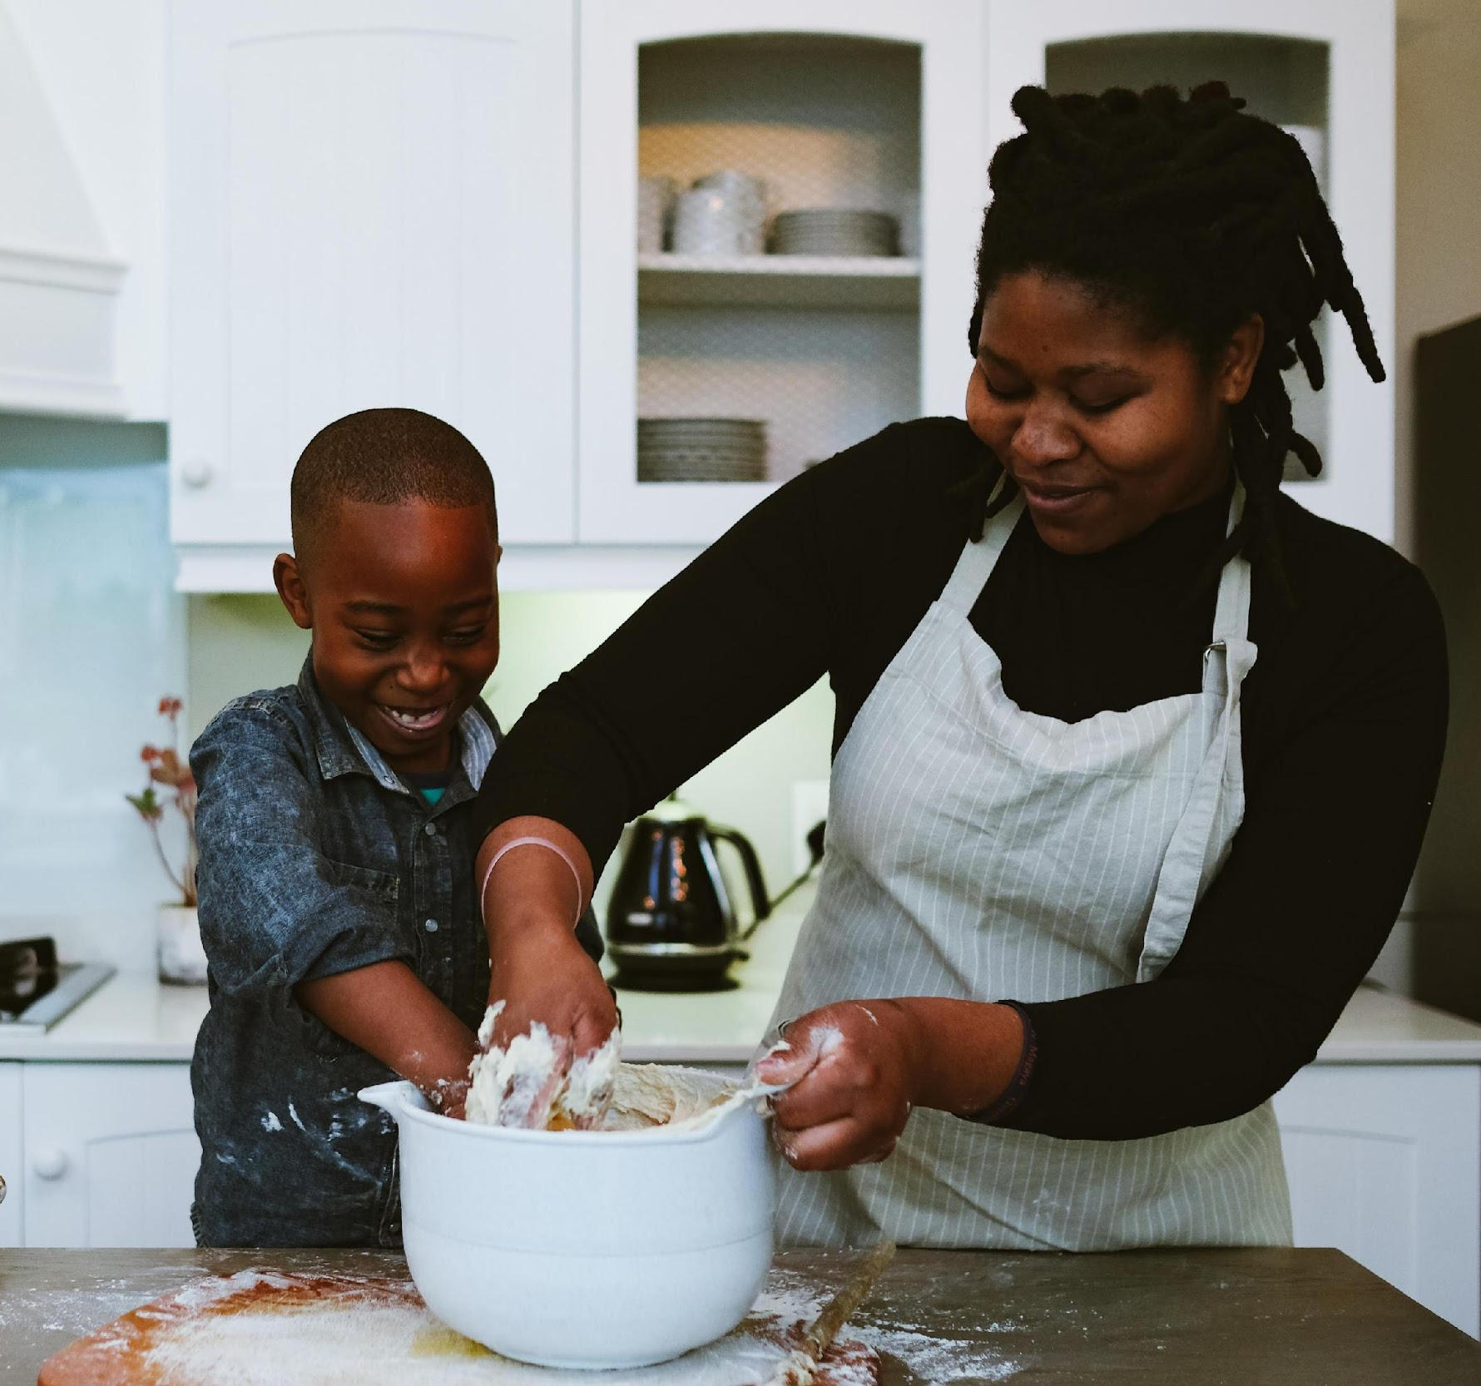
HOW does the child learn
WHAT does the child learn
HOW does the child engage with that learning
WHEN does the child learn
PROGRESS

Slide 18

REPORT CHECKING SERVICE
Education Otherwise provides a free, professional report checking service for members. Your information is confidentially as we are registered for data protection.
Report in Word
Name of local authority
Child’s age
Membership details
enquiries@educationotherwise.org

